Slide 1
A Practitioner’s Guide to Best Practices in Data Visualization
Based on the work of Camm, Jeffrey D., Michael J. Fry, and Jeffrey Shaffer. "A practitioner’s guide to best practices in data visualization." Interfaces 47.6 (2017): 473-488.

Slide 2
Data Visualization is Easy
From the point of view of good, available software, data visualization has never been easier.
Microsoft has recently updated the data-visualization capabilities in its ubiquitous Excel package to allow the creation of a wider range of charts.
Excel also has a recommended- chart option, which provides the user with a list of suggested visualizations based on the selected data.

Slide 3
Data Visualization is Hard
However, software availability does not relieve the user of the responsibility of making intelligent choices—choices that impact the effectiveness of the visualization in communicating to the audience.
Data visualization is often thought of as a descriptive tool, but it is also important for use in predictive and prescriptive analytics.
In this presentation, we provide a concise discussion of best practices for data visualization for effective communication.

Slide 4
Example
In descriptive analytics, scatter plots are useful for exploring and conveying possible relationships between pairs of variables.
Overlaid line charts are often an excellent choice for the output of predictive models when the goal is to show the model results and prediction intervals to convey the uncertainty associated with those results.
A network geographic map, with arcs showing distribution-center-to-customer-zone assignments, is an excellent way to convey the efficient structure of the solution from a supply-network optimization model.

Slide 5
Empathy for Your Audience
Regardless of the type of input data (data or model output), the creation of the visualization must be guided by the intended audience, the interests of that audience, and the message that is to be conveyed.
Empathy for your audience should be the main driver in designing your visualization.

Slide 6
How We Process Information
It is instructive to know a bit about how we process information.
The brain filters stimuli from our environment to process what is important in two main ways: unconscious and conscious,
System 1 represents the uncontrolled functions, such as reading people’s facial expressions or the immediate reaction we have to an event.
System 2 represents the controlled functions that require conscious effort, such as solving a math problem.

Slide 7
In data visualization, we leverage the pre-attentive attributes, which are System 1.We encode data in a certain way;
for example, if we highlight something with color, the reader sees this and interprets it in 250 milliseconds without even thinking about it.
Data visualization tools, when used properly, can help a reader gain a quick and correct understanding of the data being presented.

Slide 8
Design and Layout Matter
The design and layout of your visualization
should facilitate ease of understanding your message.
should draw attention to the parts of the visualization that are important in conveying your message to your intended audience.
For example,
axes should be labeled clearly and
legends should be close enough to the display to facilitate easy comparisons.

Slide 9
Avoid Clutter
Simpler is better.
Data-ink ratio
—the ratio of ink required to convey the intended meaning (data ink) to the total amount of ink used in the table or chart.

Slide 10
Use Color Purposely and Effectively
Although the use of color might be attractive to make the data visualization seem “prettier,” it can be a distraction to the audience and hinder your message.
As an example, color can be used effectively to draw attention to part of a visualization or to distinguish categories in the data; however, using too much color can distract the audience.

Slide 11
An Example: Barring Pie Charts
We have data that have yielded the percentage of students declaring each of the 12 categories of majors (plus undesignated) in a college of business.
Suppose these data are to be used as part of the recruiting process for the college.
The audience includes potential students, and one or more parents.
Possible Questions
What is the most popular major?
What is the least popular major?
What are the top three majors?
How does the major I am considering compare to the other majors in terms of its popularity?
What percentage of students are undesignated?

Slide 12
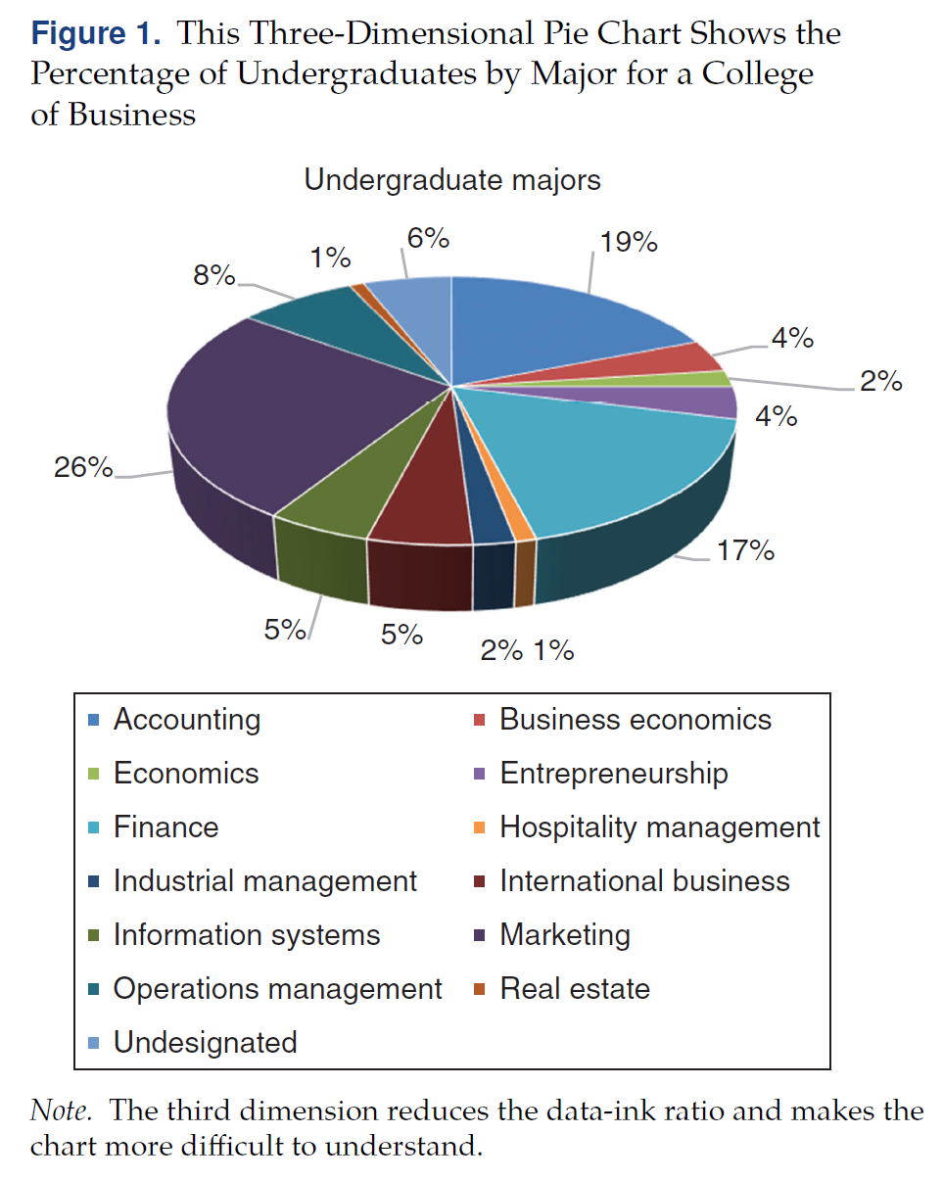
Figure 1.
The data that we have available are the percentage of the total student population in each major.
Illustrates a part-to-whole relationship—the percentage breakdown of the total for the variable under consideration.
Pie charts are often touted as being useful for showing this part-to-whole relationship

Slide 13
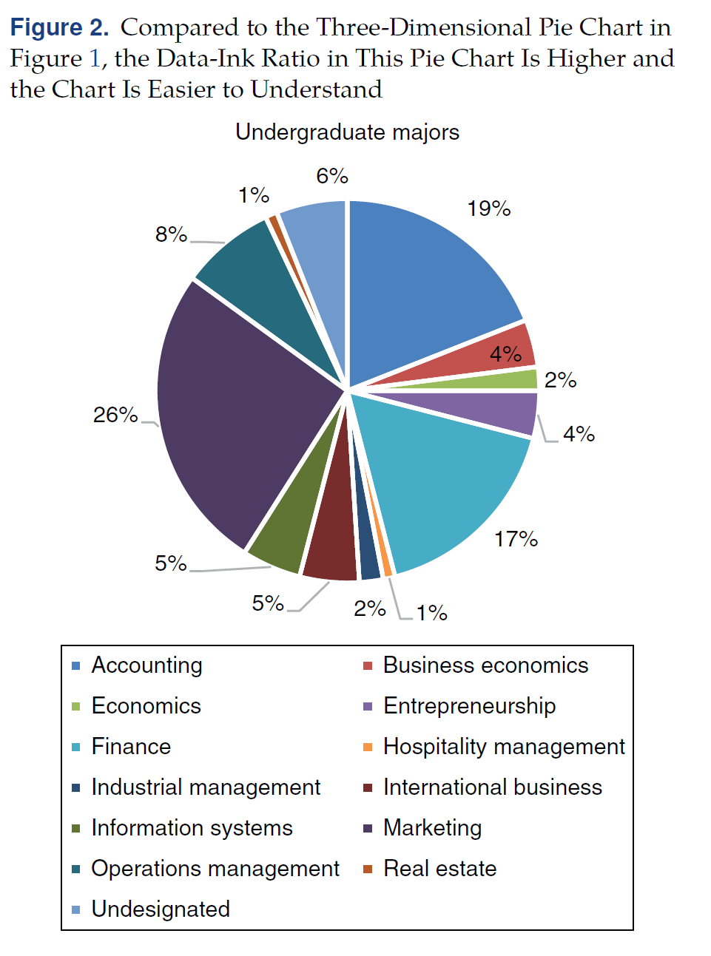
Figure 2
Consider Figure 2 in which we have eliminated the unnecessary third dimension.
Difficult to see the legend and the colors associated with each major.
With 13 categories, many of the colors are very similar, which also makes comparison difficult.
Humans are also good at measuring the position of objects; for example, how far one person is standing from another. However, they are much less adept at accurately measuring angles, arcs, and area, and comparing them against each other.

Slide 14
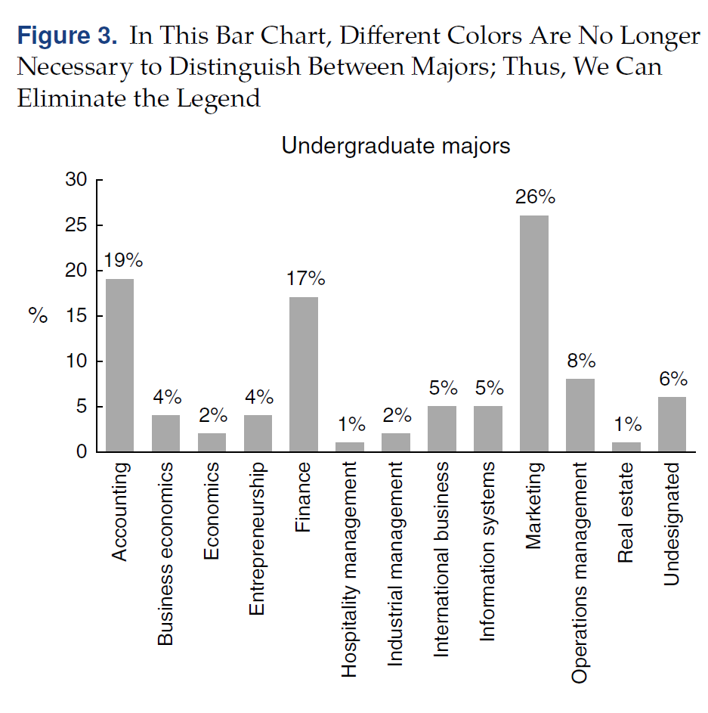
Figure 3
Figure 3 shows a vertical bar chart of the data on business college majors. The differences in college majors are much easier to visualize in this figure than in either Figures 1 or 2.
Can we improve upon Figure 3? If we think about how this chart will be used, perhaps sorting the data from high to low would make the chart easier to read and more useful for the reader.

Slide 15
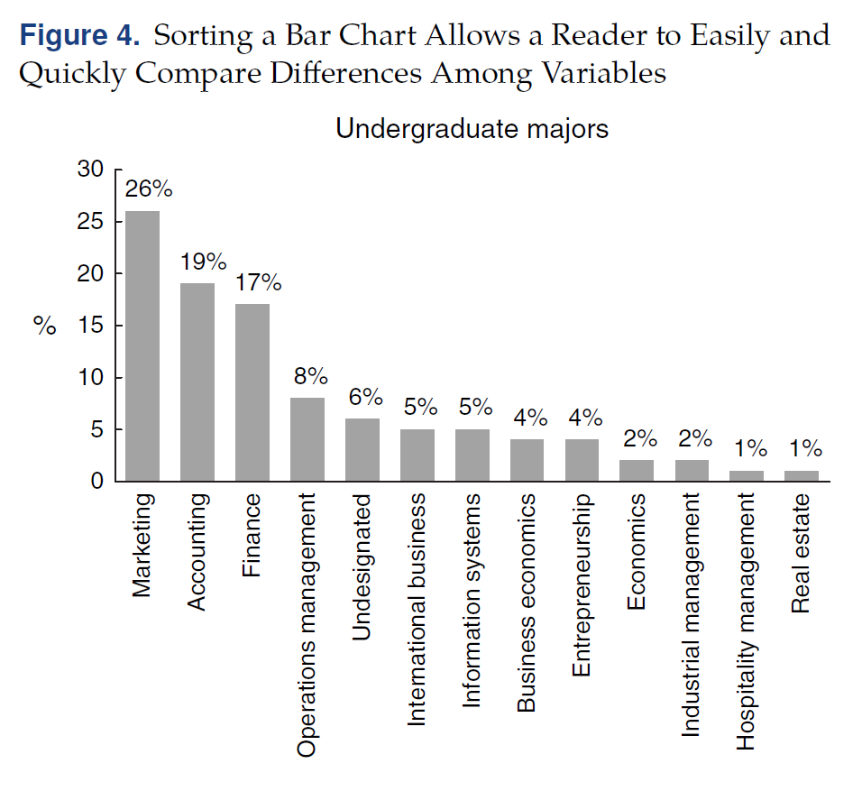
Figure 4
Figure 4 shows the same vertical bar chart sorted.
Sorting allows the reader to more easily find the highest and lowest percentage majors and to compare majors that are close in percentage

Slide 16
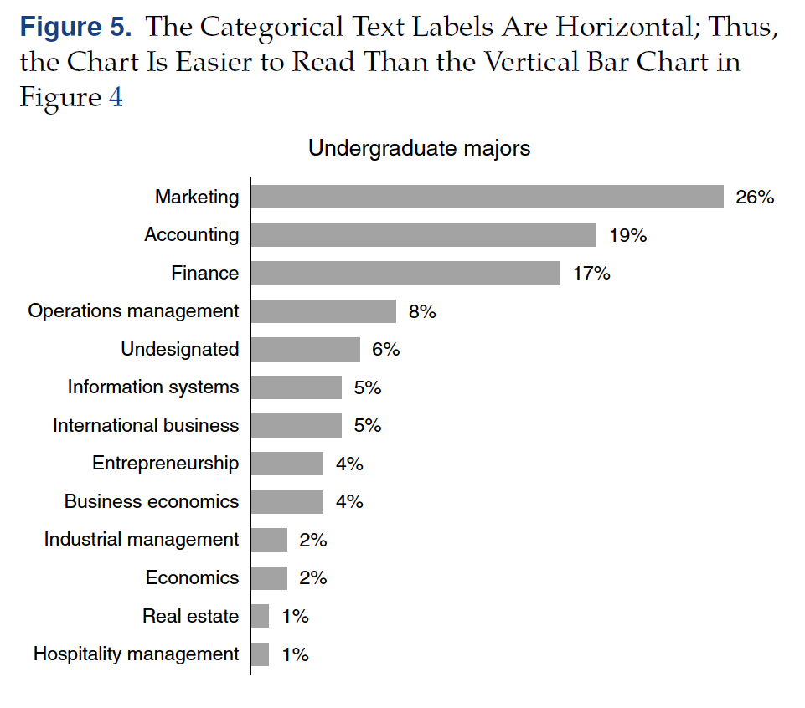
Figure 5
Finally, our adeptness at comparing lengths is not impaired using a horizontal display versus a vertical display.
Figure 5 displays a horizontal bar chart, which is a better design for the same data; the categorical text labels are easier to read because they are oriented horizontally.

Slide 17
Example Summary
With this simple example in Figures 1–5, we have illustrated the following three general principles
Design and layout matter: Use them effectively. We evolved from a pie chart to a bar chart to a sorted bar chart, and we then rotated the bar chart for ease of reading.
Avoid clutter: Too many labels, values, lines, and dimensions hinder the reader in interpreting the data. We eliminated the distracting third dimension.
Use color purposely and effectively: Use it only when it is needed to distinguish categories or draw the attention of the reader.

Slide 18

Design and Layout Matter: Types of Comparisons and Chart Types
Several primary comparisons can made when visualizing data.
The type of comparison being made is critical when determining the type of data visualization or chart type.

Slide 19
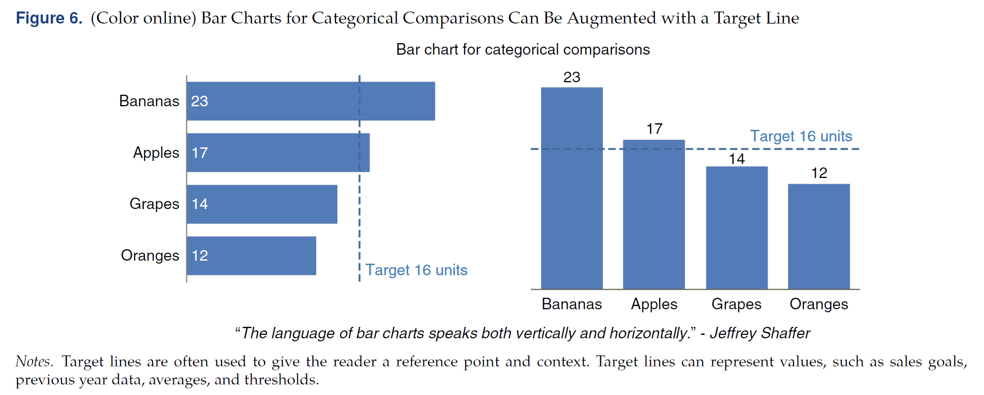
Bar Chart
A bar chart, either vertically or horizontally, is a great choice for making quick and precise categorical comparisons.

Slide 20
Designing a Bar Chart
In designing a bar chart, consider the following
Order the data to provide additional context.
For a small number of bars, consider data labels.
If the chart must include many categories, then balance the use of axis labels with data labels. Both are unnecessary.
Avoid rotated text.
Mute or remove gridlines and remove chart borders.
Always start the axis at zero on a bar chart or any other chart that encodes data using length or height (e.g., bar chart, histogram, lollipop chart, area chart). otherwise, the visual comparison is incorrect and can be misleading.

Slide 21
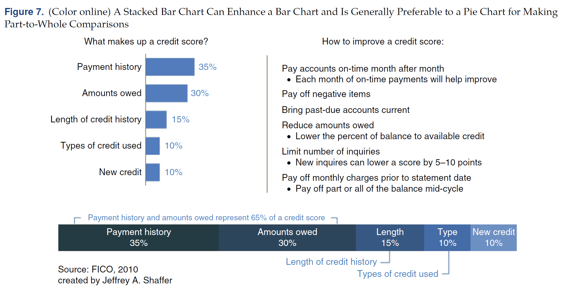
Stacked Bar Chart
In addition, the part-to-whole comparison is often necessary. Unfortunately, this is often shown as a pie chart, which for the reasons previously discussed, most data-visualization experts consider to be bad practice.
To emphasize comparisons among categories and part-to-whole comparisons, the bar chart can be supplemented by a stacked bar chart

Slide 22
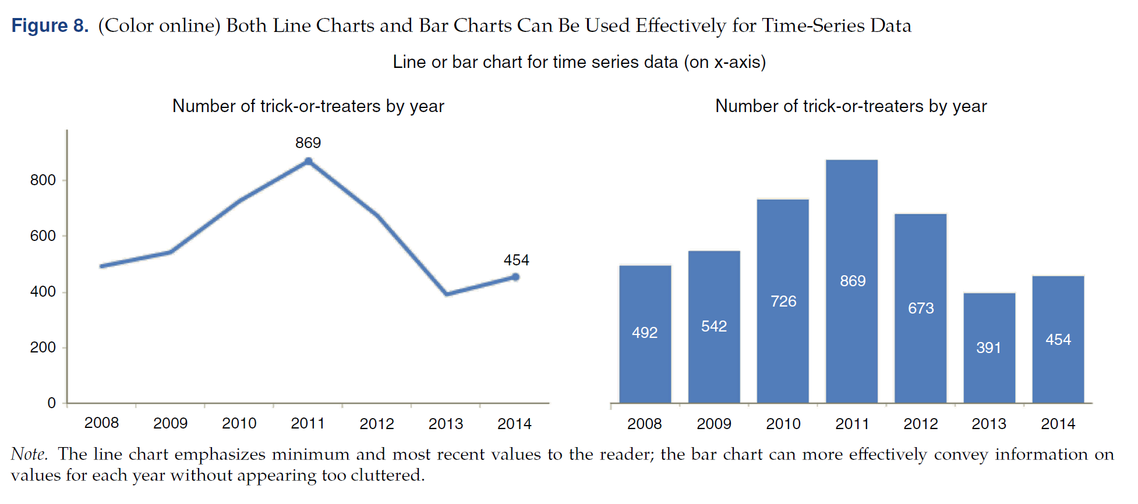
Time-Series Chart
Another very common comparison in data visualization is showing a trend over time. Time should generally be on the horizontal axis.
Line charts are great for visualizing a trend, but a bar chart can also be used.

Slide 23
Designing a Time-Series Chart
In designing a time-series chart, consider the following:
Time should be on the horizontal axis; time should progress from earlier to later and read from left to right.
If using bars to represent time, do not break the axis. Bars must begin at zero. It is acceptable to break the axis on a line chart; however, it has a magnifying effect on the visualization, making the visual slope of the line appear much more dramatic as the magnification increases.
Plot consistent time periods using a line chart. If time periods are missing or unequal, then note this and deal with it in the visualization; for example, use a dotted line where years are missing.

Slide 24
Use of Dots
The use of dots can be effective in various visualization methods. This includes making comparisons, showing time-series data when an interval is missing, plotting a distribution, or showing a correlation between variables. If possible, avoid using shapes other than dots or circles.
Circles and dots have a single center point that is clear to readers. Triangles, squares, asterisks, stars, or other shapes hinder the reader in making a quick and accurate determination of the center of the point.

Slide 25
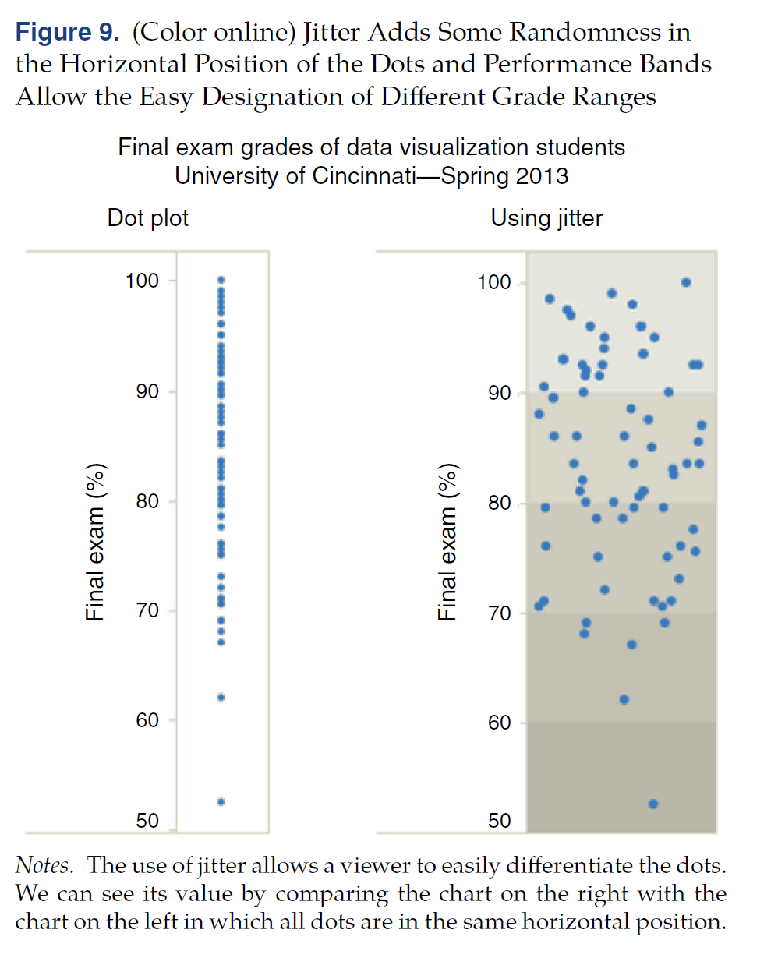
Dot Charts
Figure 9 shows an example of a dot plot, also known as a strip plot, to visualize the grades in a data visualization class.
A standard dot plot is on the left; the same plot using jitter and background shading for the performance bands (50 to 100 percent) is on the right.
Jitter allows the reader to more easily observe differences in values that would otherwise be plotted on top of each other;

Slide 26
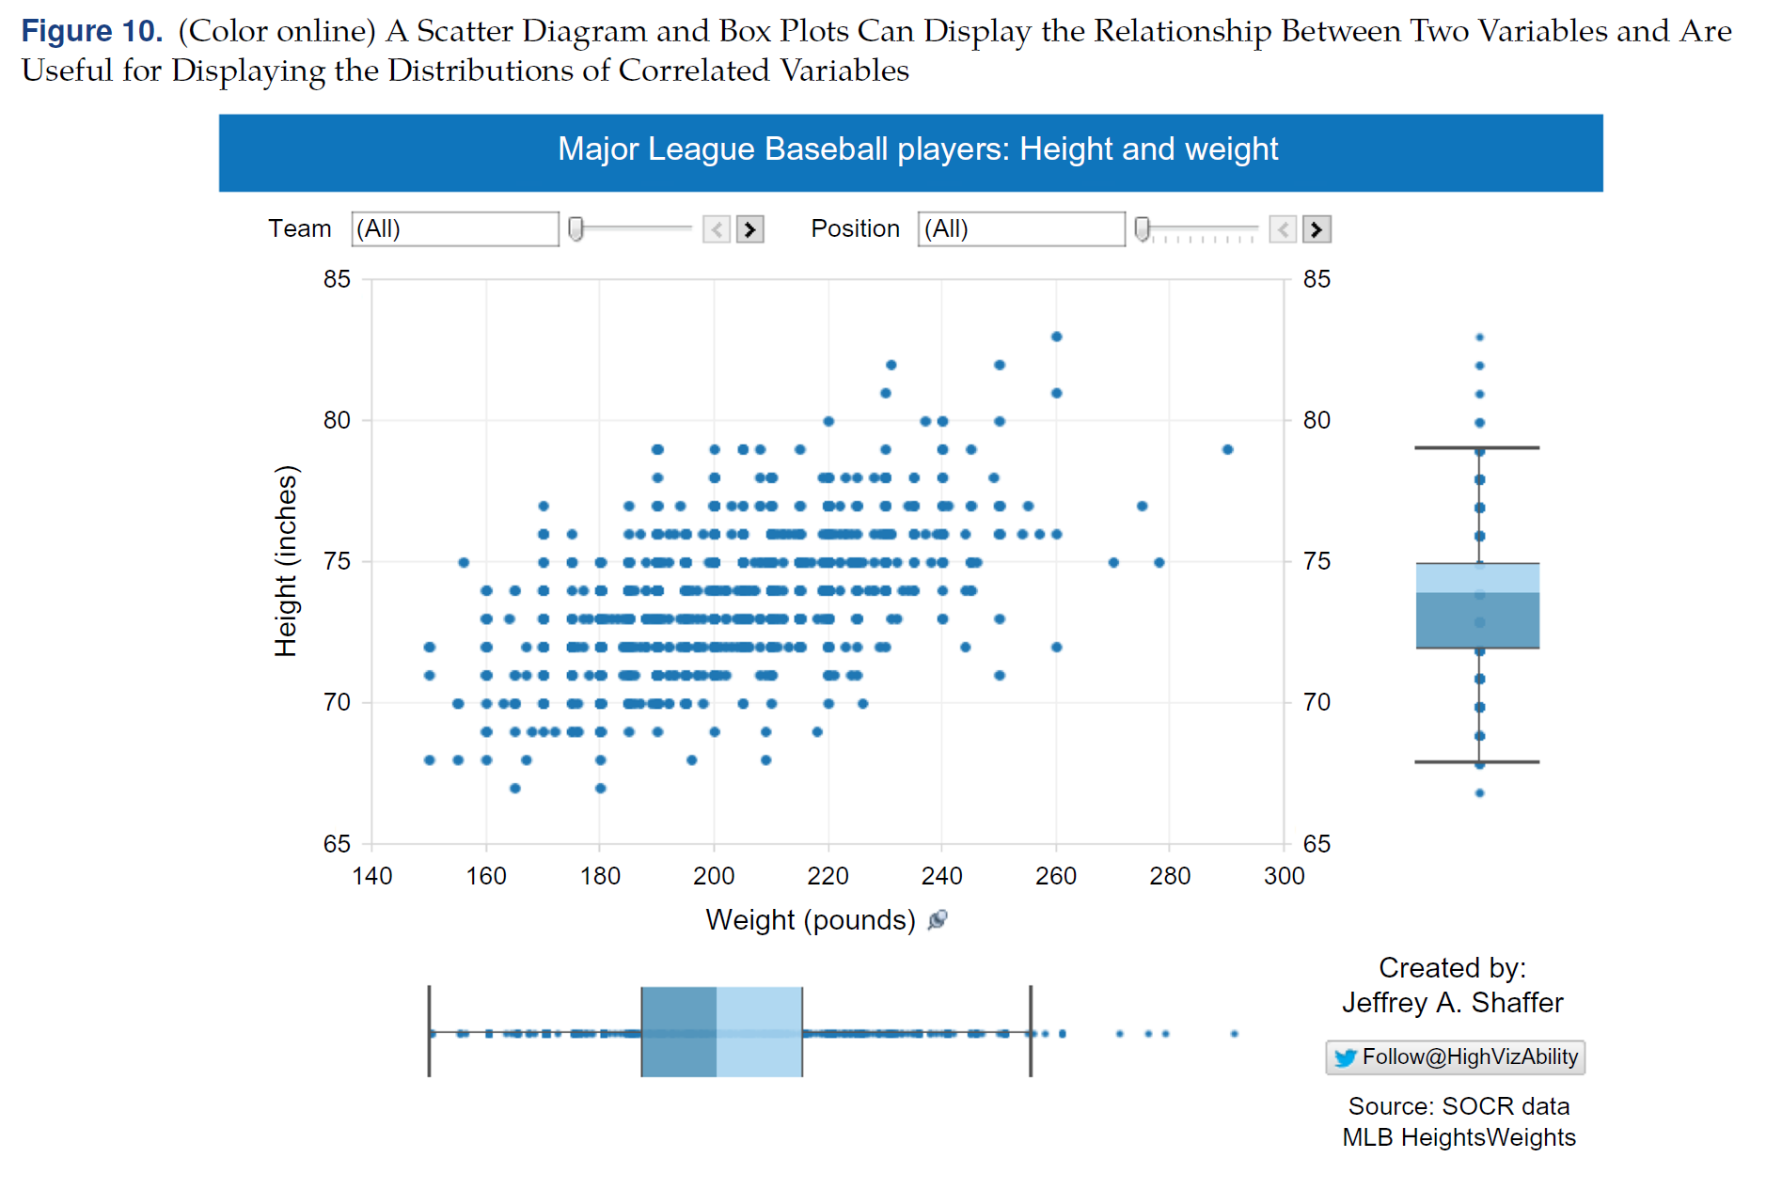
Scatter Plot
Dots can also be used in a scatter plot

Slide 27
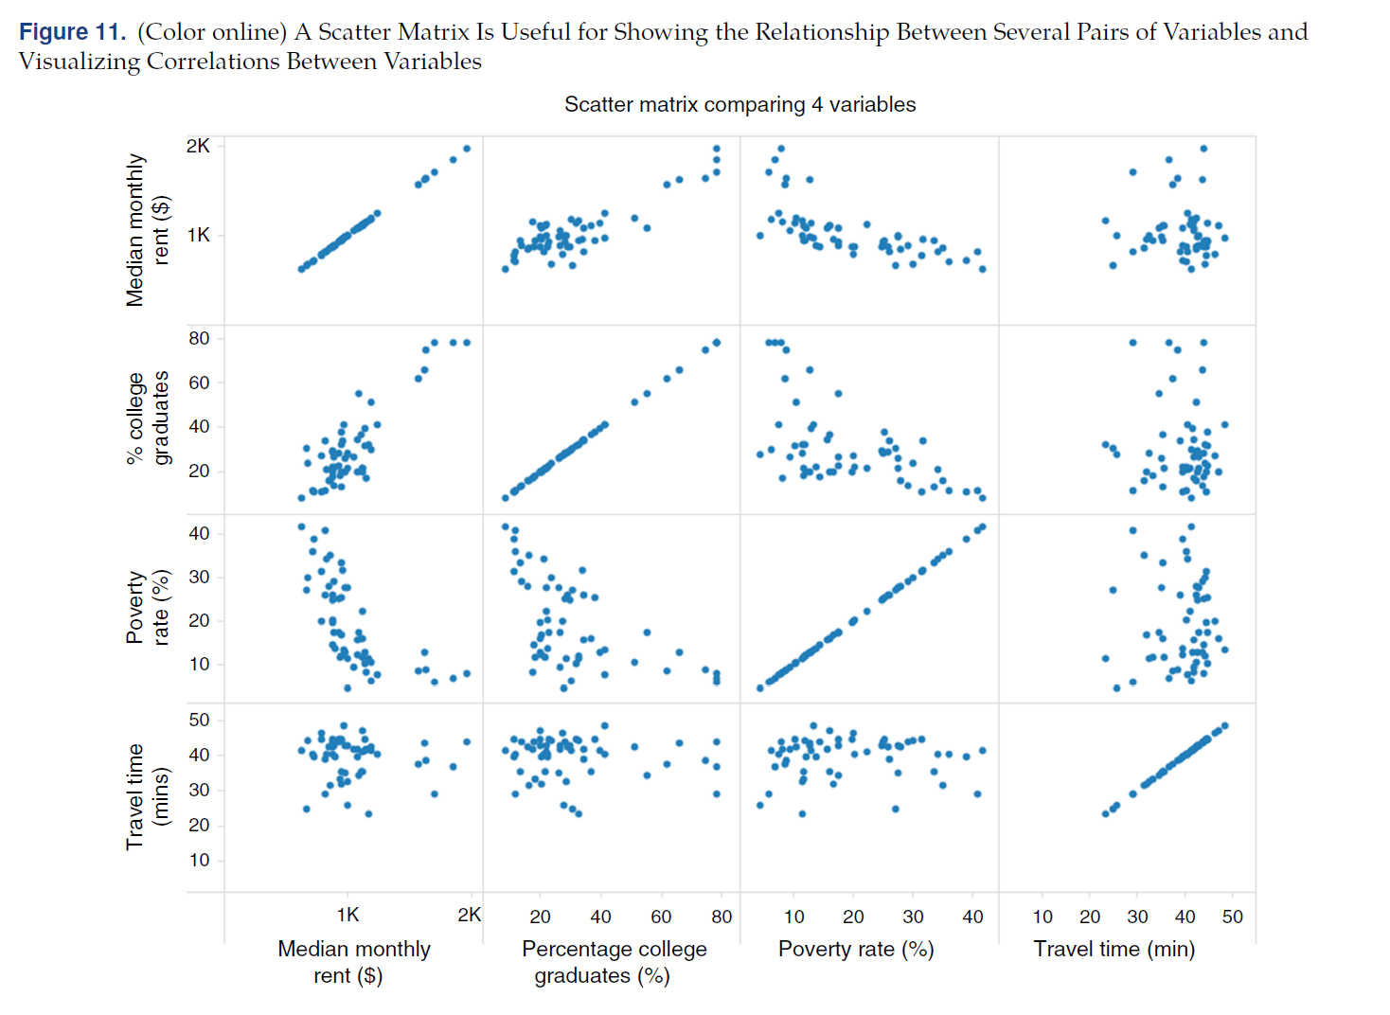
Scatter Matrix
Scatter plots are also suitable in comparing many variables using a scatter matrix—a matrix that displays correlations among multiple variables.

Slide 28
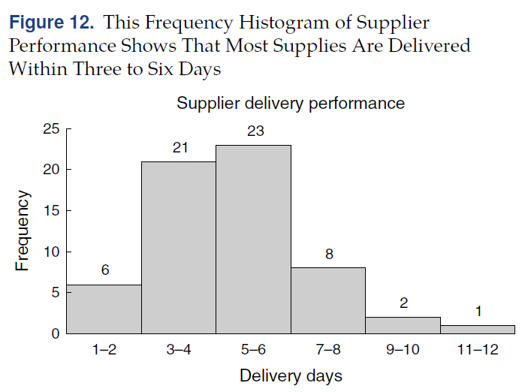
Histogram
A histogram is a basic chart type that is used to display the distribution of data and compare frequencies across bins of ranges. Figure 12 shows a histogram of delivery times (in days) for a supplier.

Slide 29
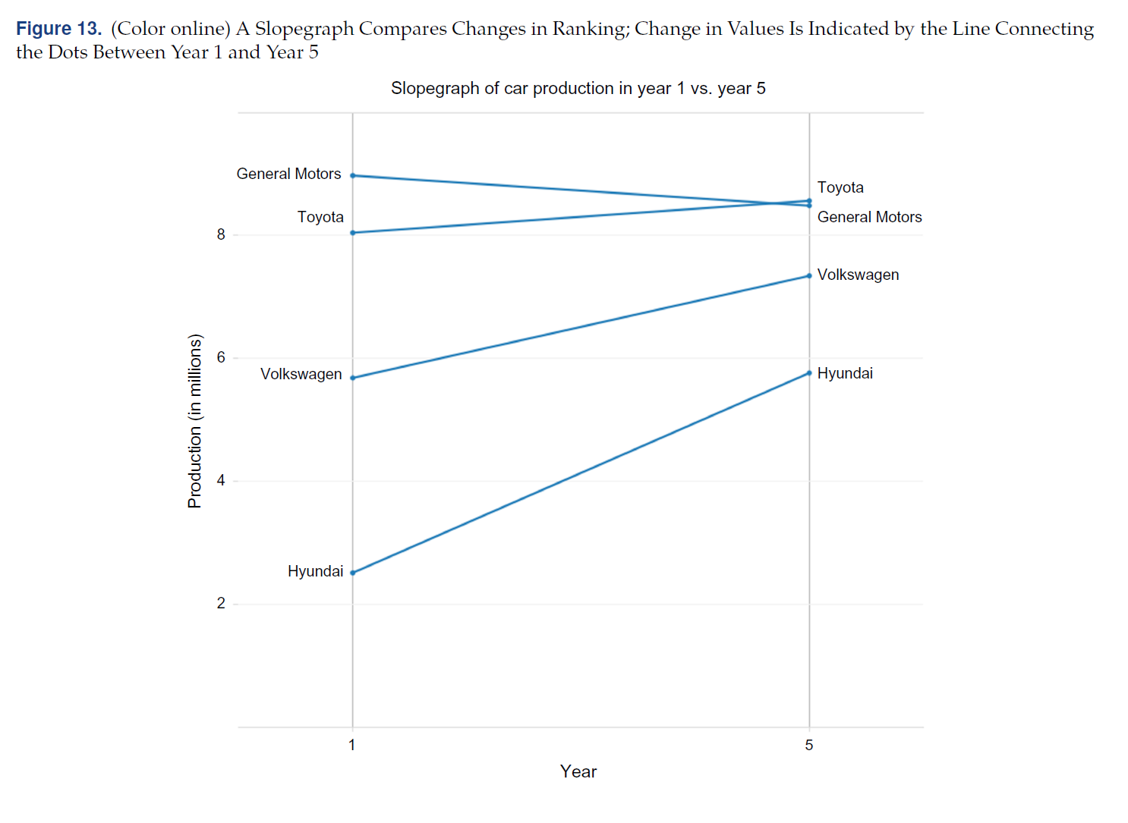
Slope Graph
Another common comparisonmeasure is rank order.
A slope graph is useful for this type of comparison. Figure 13 shows an example of the change in car production from Year 1 to Year 5 for car manufacturers.

Slide 30
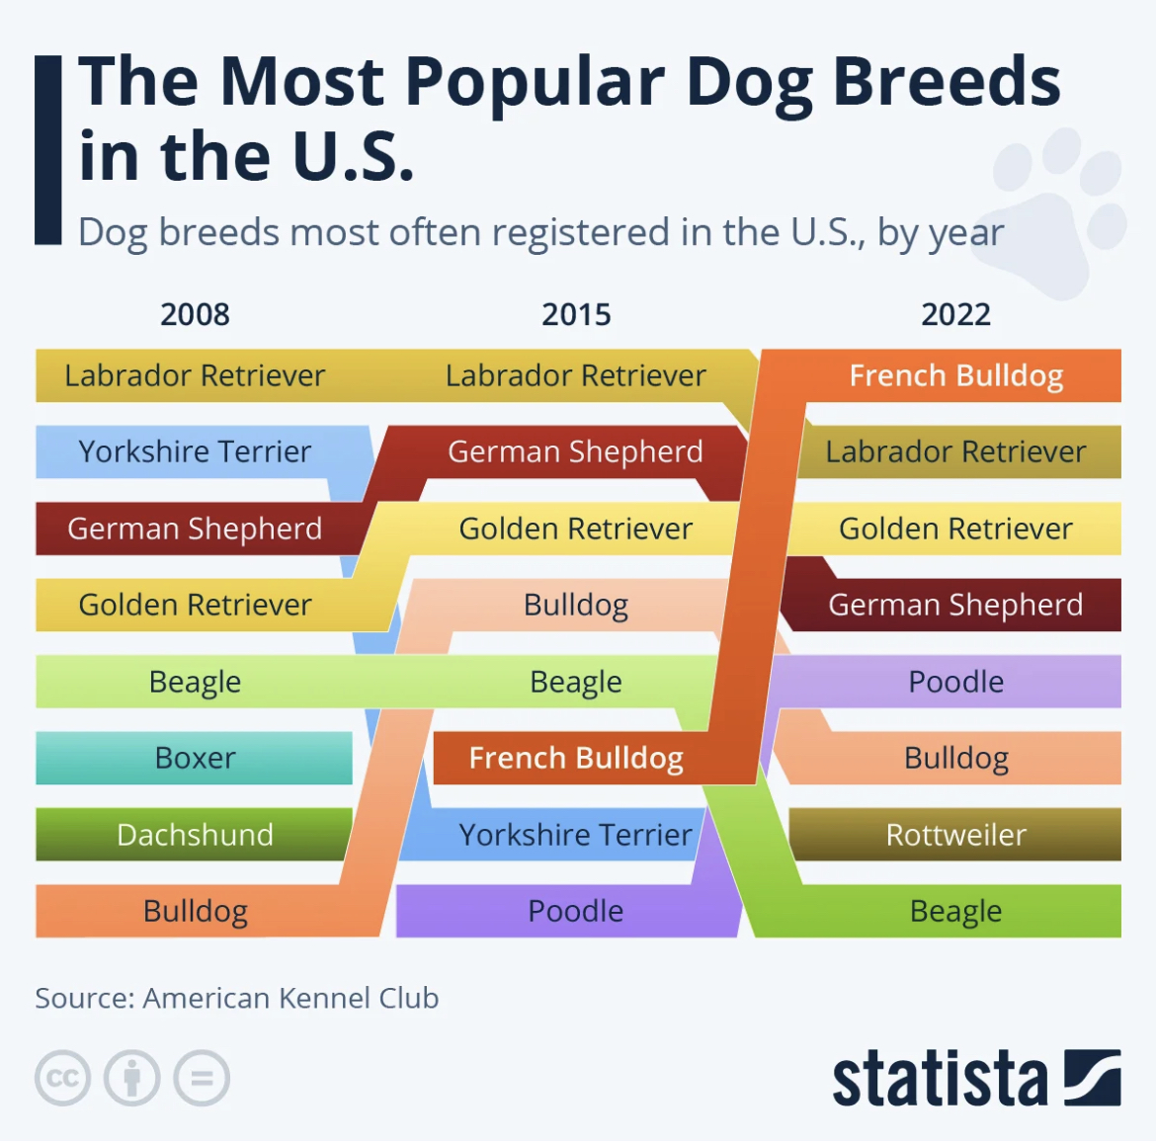
Slope Graph
Another slope graph.

Slide 31
Avoid Clutter
Any element that does not contribute to the intended message of a data visualization is clutter.
Clutter distracts from the message of the visualization; therefore, it requires more mental effort on the part of the viewer.

Slide 32
Gestalt Principles of Visual Perception
Knaflic (2015) discusses the Gestalt Principles of Visual Perception and how they can aid in eliminating clutter. These six principles, which allow us to create order from visual stimuli are:
Proximity: We place objects that are close together in a group;
Similarity: We place objects with the same shape and (or) color in a group;
Enclosure: We place objects that are enclosed in a group;
Closure: If enough of a shape is shown, we map the shape to something familiar to us;
Continuity: We expect objects that follow a path or curve to be more related than those that do not;
Connection: We place objects that are connected in a group.

Slide 33
Example
Assume we have 24 years (Periods 1–24) of budget data (measured in billions of dollars) and wish to predict the budget for the next four years (Periods 25–28).
Using linear regression, we obtain a predictive model budget where t is the period.
Our objectives in constructing a graphic are to convey to our audience of budget analysts how well the predictive model fits historical data, to show the predictions from the model, and to emphasize the uncertainty associated with those predictions.

Slide 34
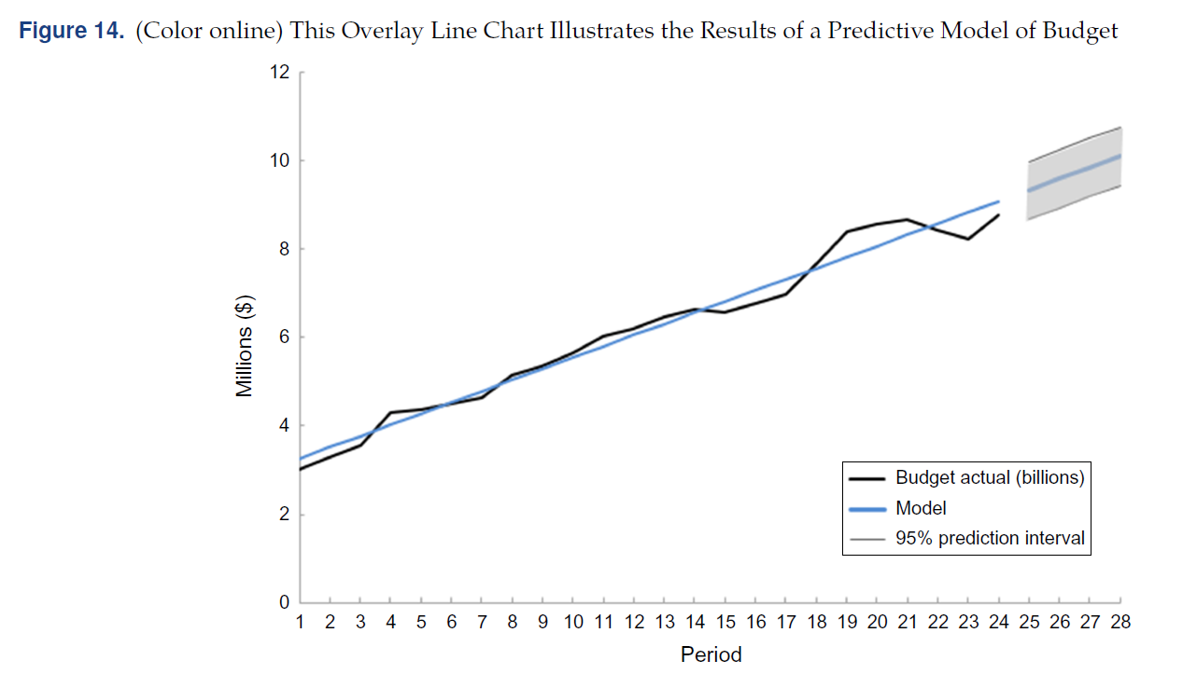
Regression with an Overlaid Line Chart
Figure 14 shows the results of this regression with an overlaid line chart. We use continuity with the darker (black) line giving the observed budget over time and the lighter (blue) line the estimated

Slide 35
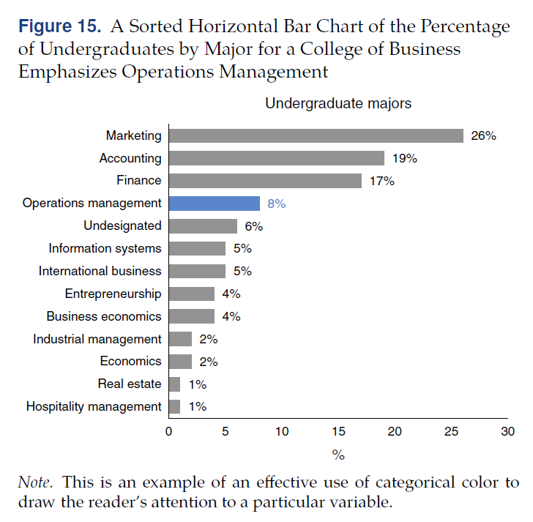
Bar Chart
Color should not be used simply to “spice up” a visualization or to avoid a “boring” visualization. It should be used purposefully.

Slide 36
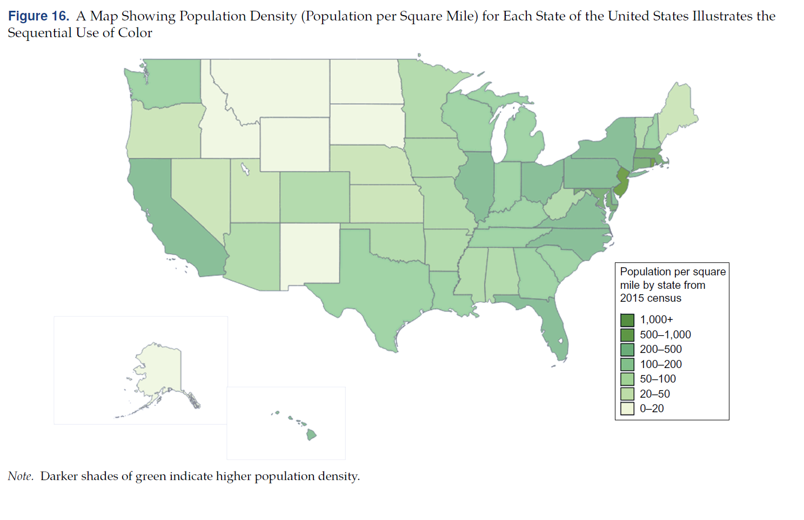
Map
Figure 16 shows an example of sequential use of color—a map showing the population density (population per square mile) for each state in the United States.

Slide 37
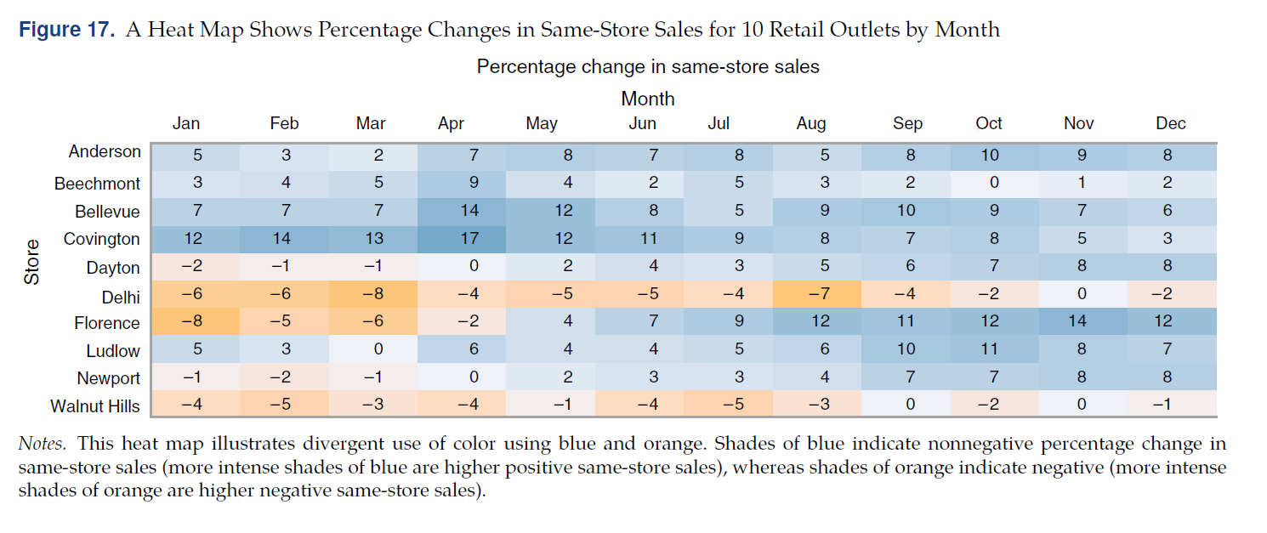
Heat Map
Figure 17 shows a diverging use of color. The figure uses a blue-orange scale to show monthly same-store sales for 10 retail outlets.

Slide 38
Final Example
One final example that illustrates
the use of the three data visualization principles and
the use of a visualization for communicating visually the output and recommendation from a prescriptive model
Example Background:
Make-versus-buy decision.
Known demand for 15 fabrics.
Can be made on a dobby loom or a regular loom or subcontract.
Optimization problem.
Objective: to develop a graphical display to communicate to management the model’s recommendation and give insights on why the solution makes sense.

Slide 39
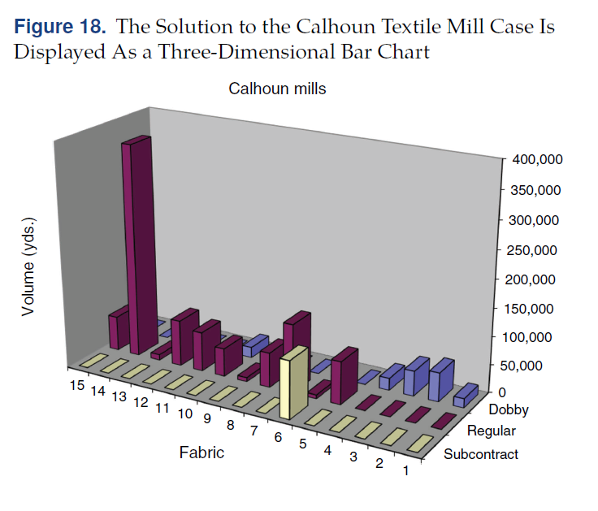
First Attempt
At first, seduced by Excel’s three-dimensional graphing capability, used Figure 18 to convey the recommendation and explain the solution.
This figure clearly violates all three of the guiding principles we presented.

Slide 40
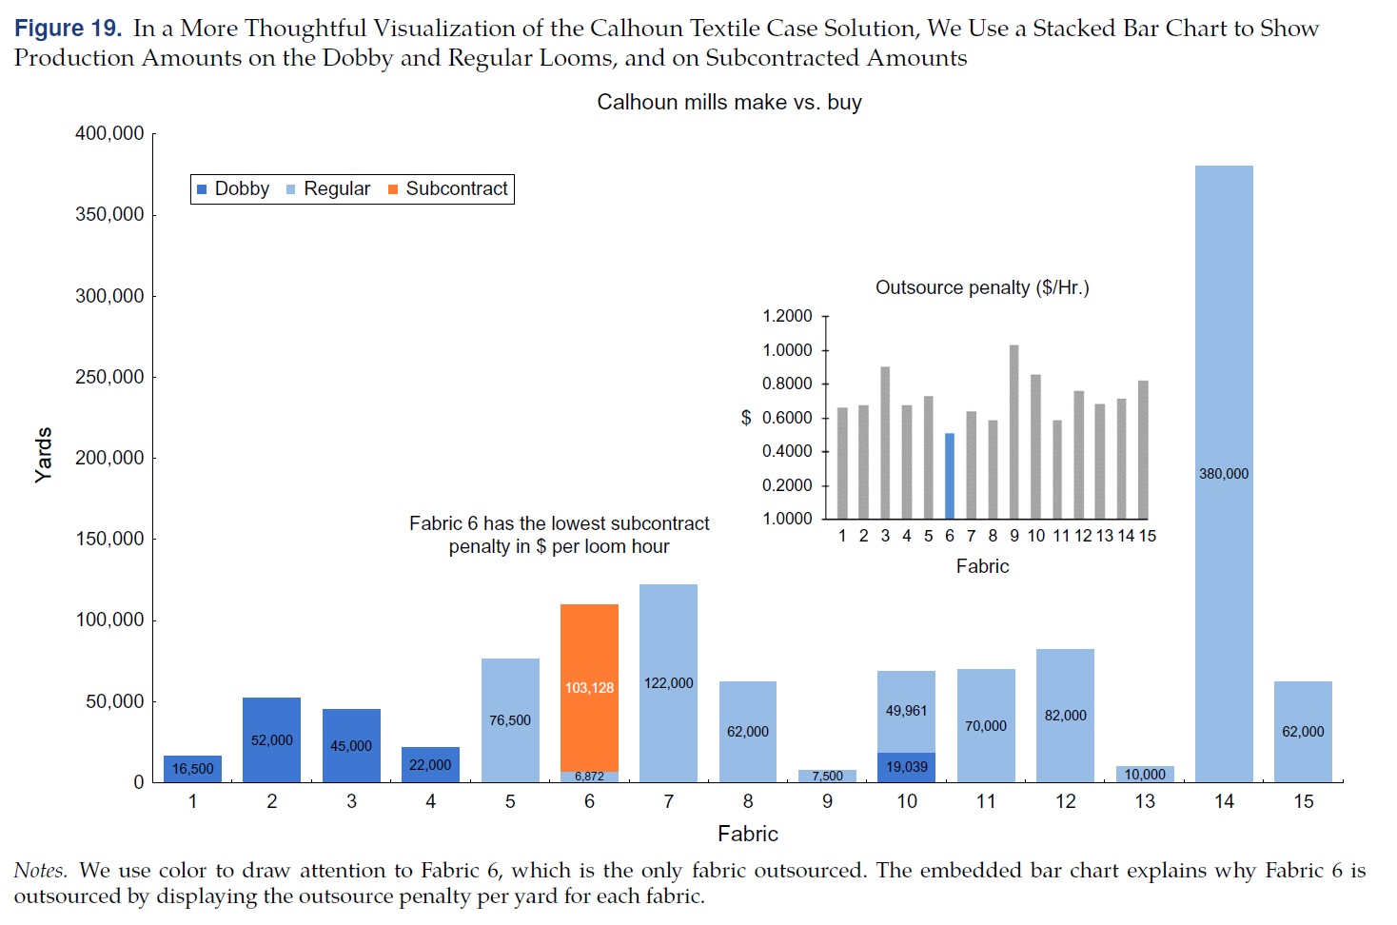
Final Attempt
In Figure 19, we use color and a stacked bar for each fabric.

